Slide 1
YouTube Comment Analyzer

Slide 2
Definition
A YouTube Comment Analyzer is a system or tool that automatically collects, processes, and analyzes comments associated with YouTube videos. It utilizes various techniques, including natural language processing (NLP) and sentiment analysis, to derive insights into user sentiments, engagement, and topics discussed in the comments section.

Slide 3
Tools
Programming Language: Use a programming language such as Python for implementing the analyzer due to its extensive libraries and frameworks for data analysis.
IDE (Integrated Development Environment): Choose an IDE like Jupyter Notebook or Visual Studio Code for developing and testing your code.
Version Control: Utilize version control systems like Git to track changes and collaborate on the project.
Collaboration Tools: Use collaboration tools like GitHub for version control and project management.

Slide 4
Resources
YouTube Data API: [YouTube Data API Documentation]
NLP Libraries: SpaCy ([SpaCy Documentation]
Machine Learning Models: Scikit-learn ([Scikit-learn Documentation]
Visualization Tools: Matplotlib ([Matplotlib Documentation],Seaborn ([Seaborn Documentation],Plotly ([Plotly Documentation]
Kaggle : for dataset train and test our model.
Websites
Socialbee
Hootsuite
Brandwatch
https://commentanalyzer.com

Slide 5
Flow
1. Extract Data from YouTube :
Use the YouTube Data API to extract comments and related information from a specific video.
2. Data Preprocessing:
Tokenization: Breaking down comments into individual words or tokens.Removing stop words
Lemmatization: Reducing words to their base or root form.
3. Sentiment Analysis Model:
Train a sentiment analysis model using machine leargning techniques. You can use a pre-trained model or train one using labeled data. The goal is to classigfy comments into categories like positive,negative, or neutral based on sentiment.
4. Insights and Reporting:
Generate report summarizing the finding from the sentiment analysis. Provide positive negative and neutral comments

Slide 6
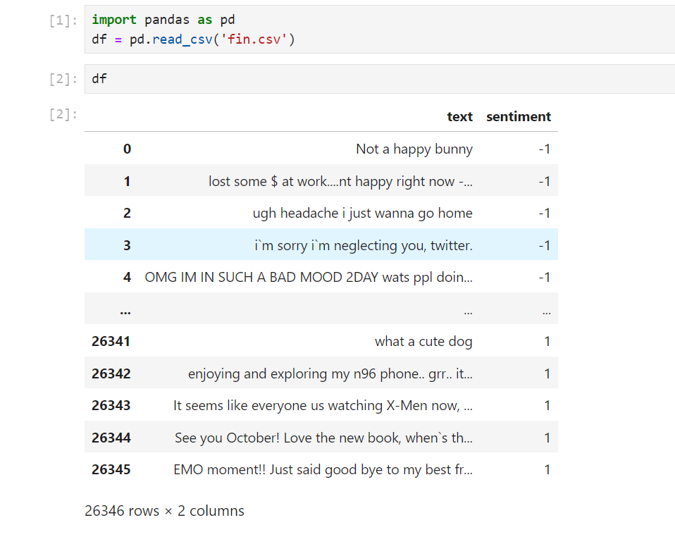
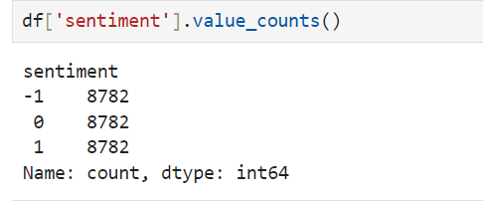

Slide 8
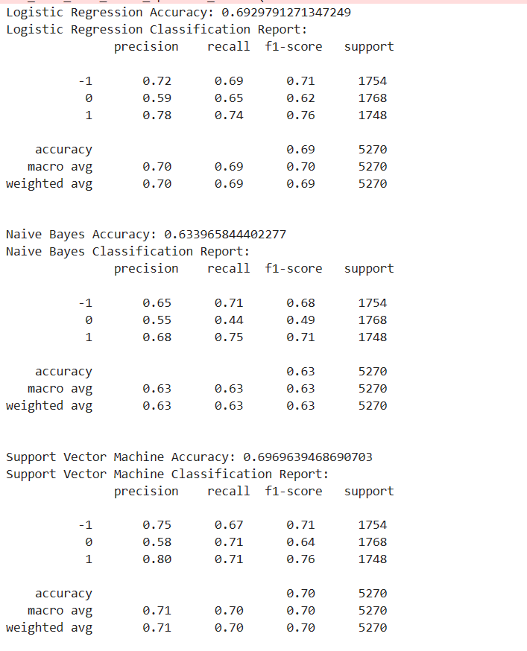
Train_model with TFIDF

Slide 9
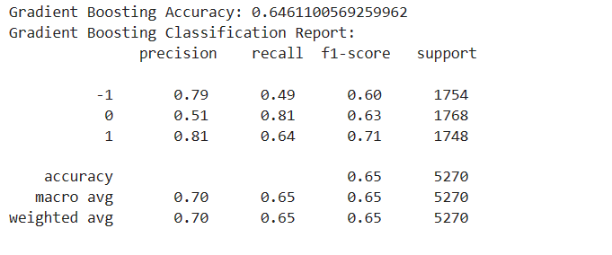

Slide 10
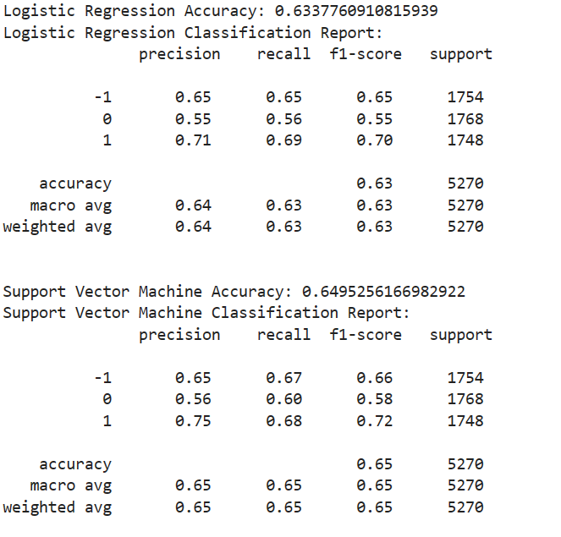
Train_model with Word Embedding

Slide 11
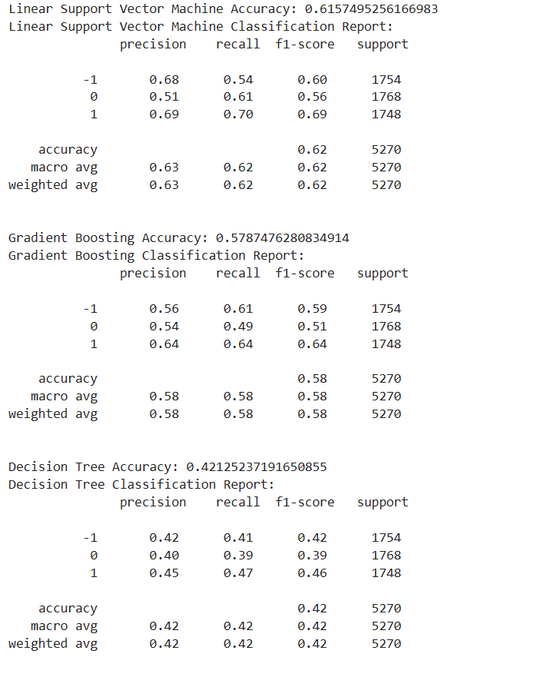

Slide 12
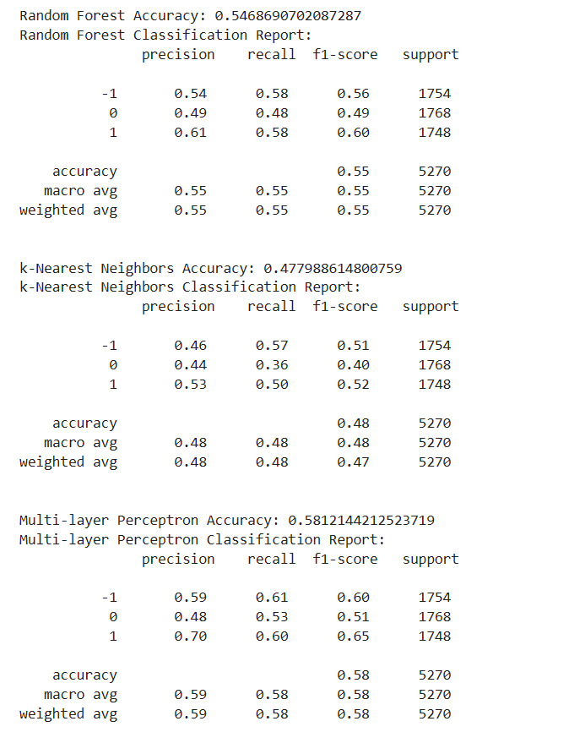

Slide 14
